Slide 1
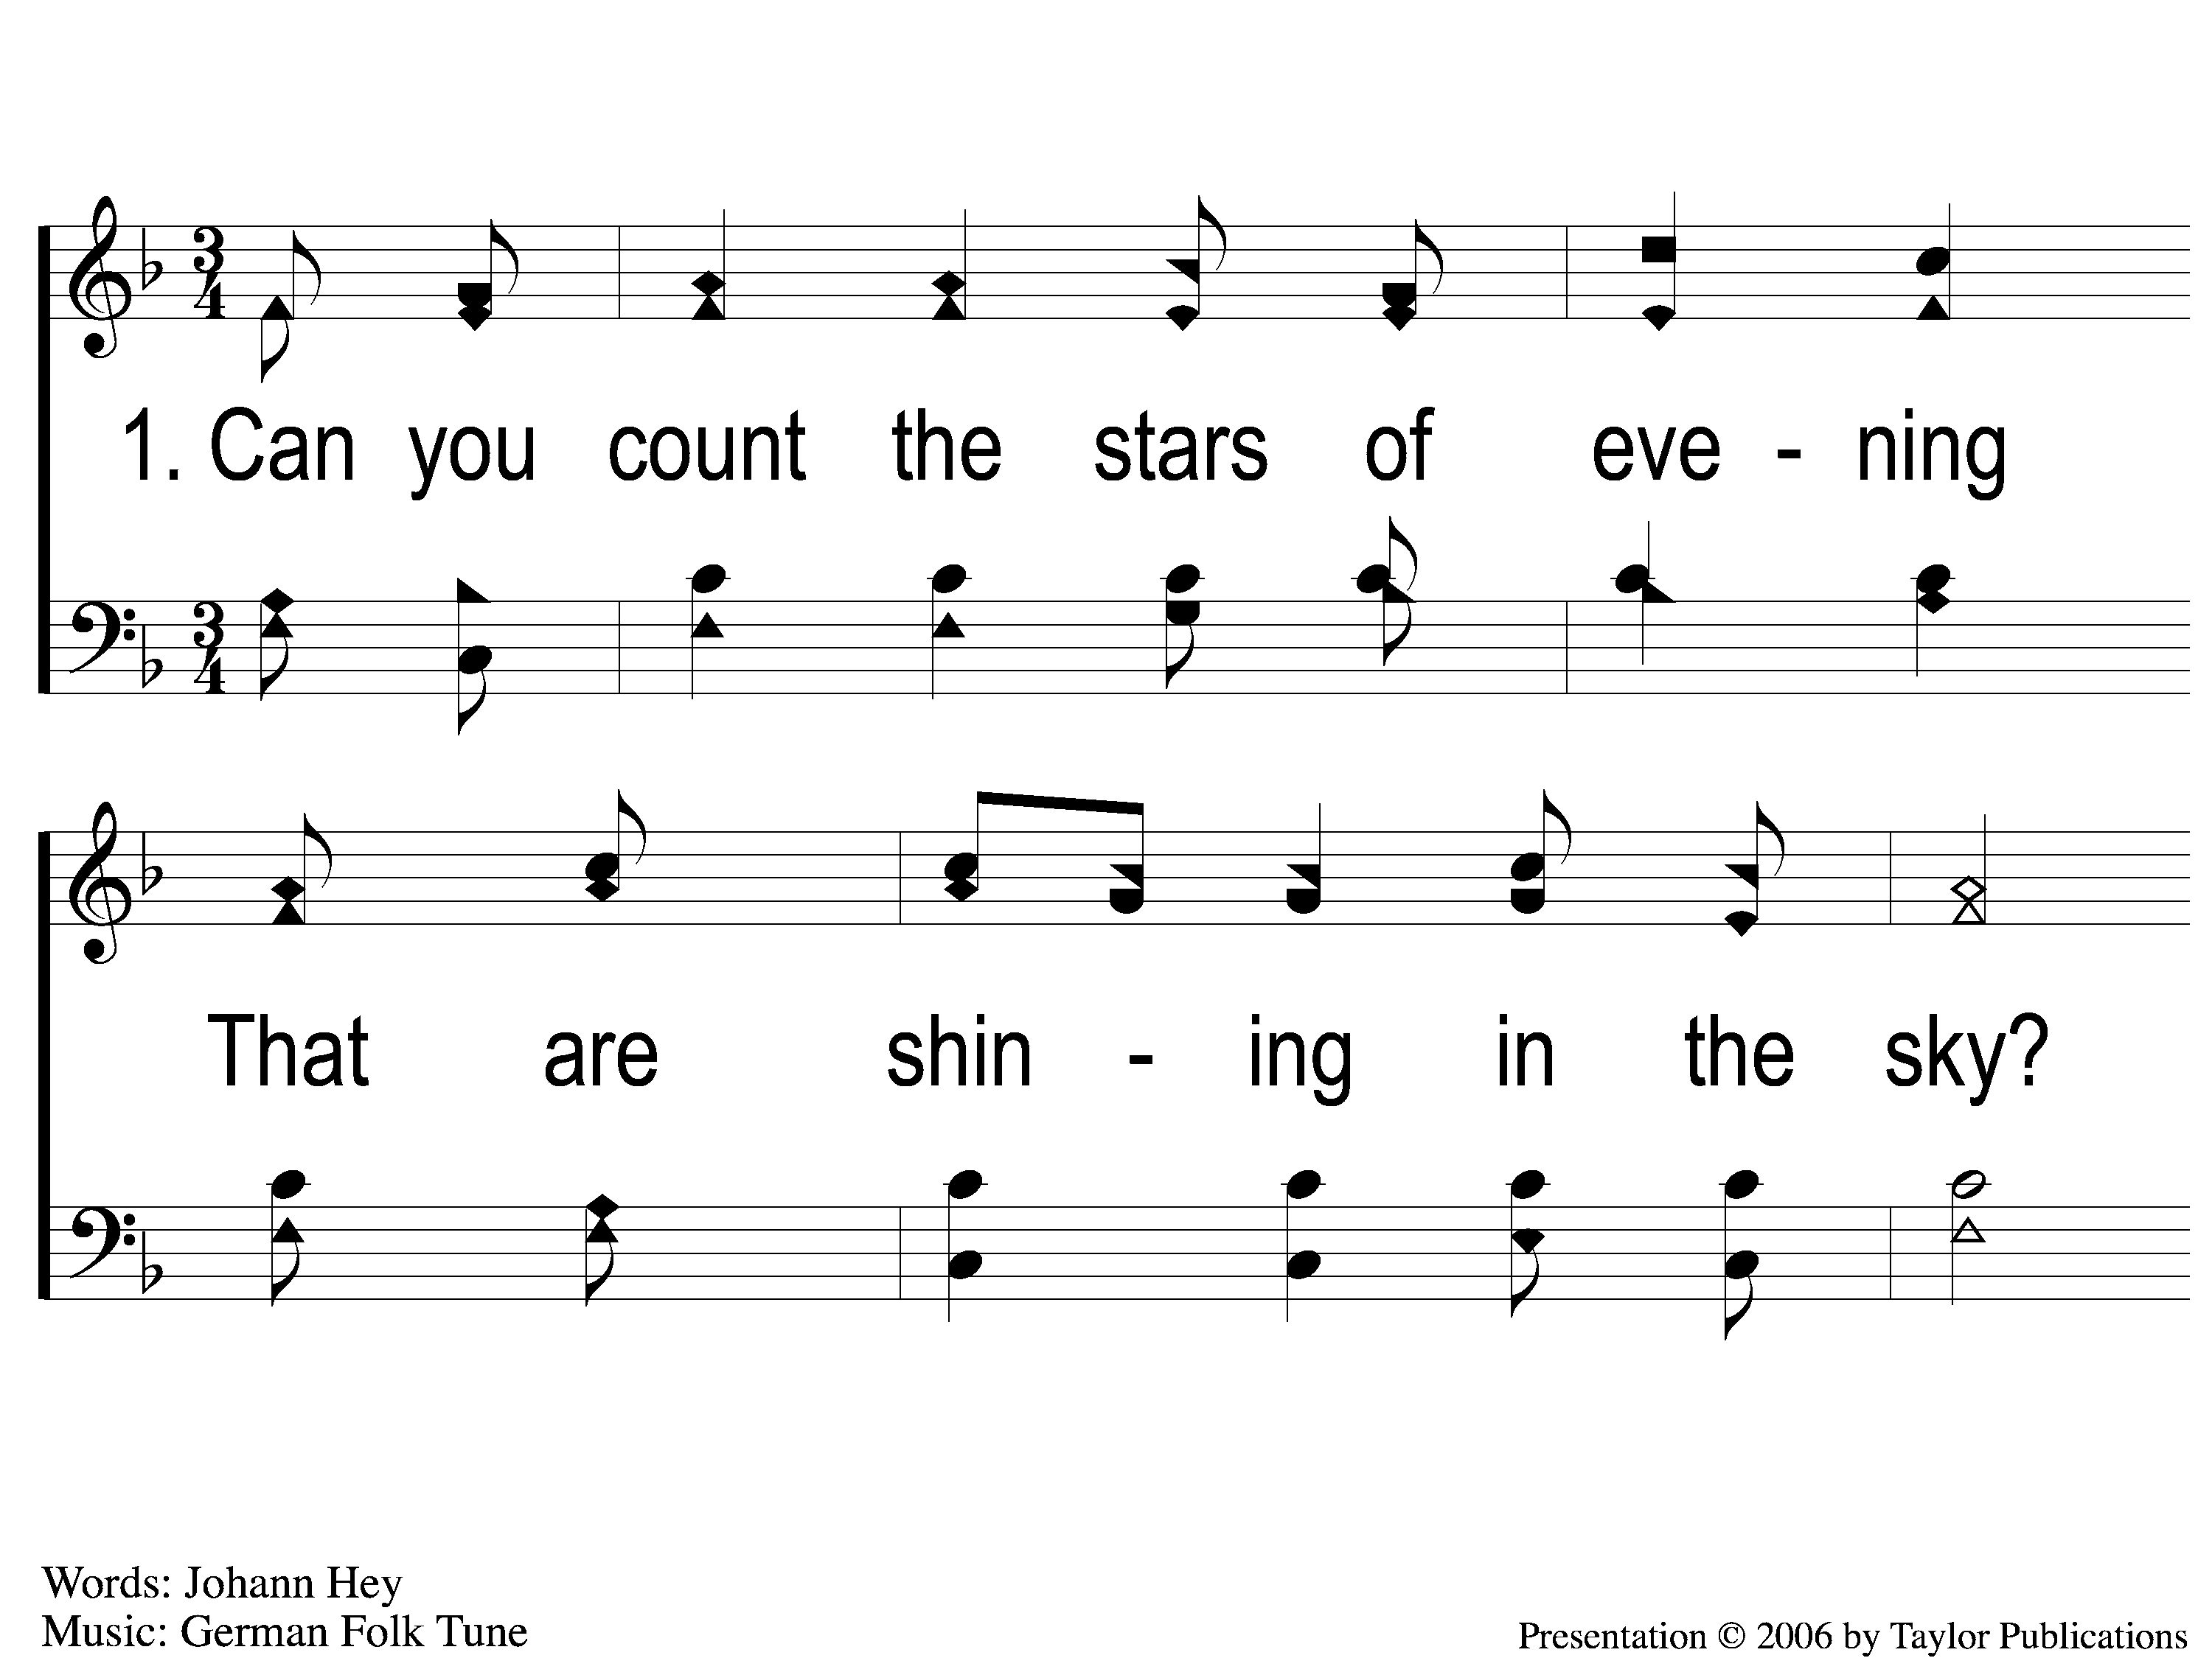
1-1 Can You Count the Stars?
Can You Count The Stars?
70

Slide 2
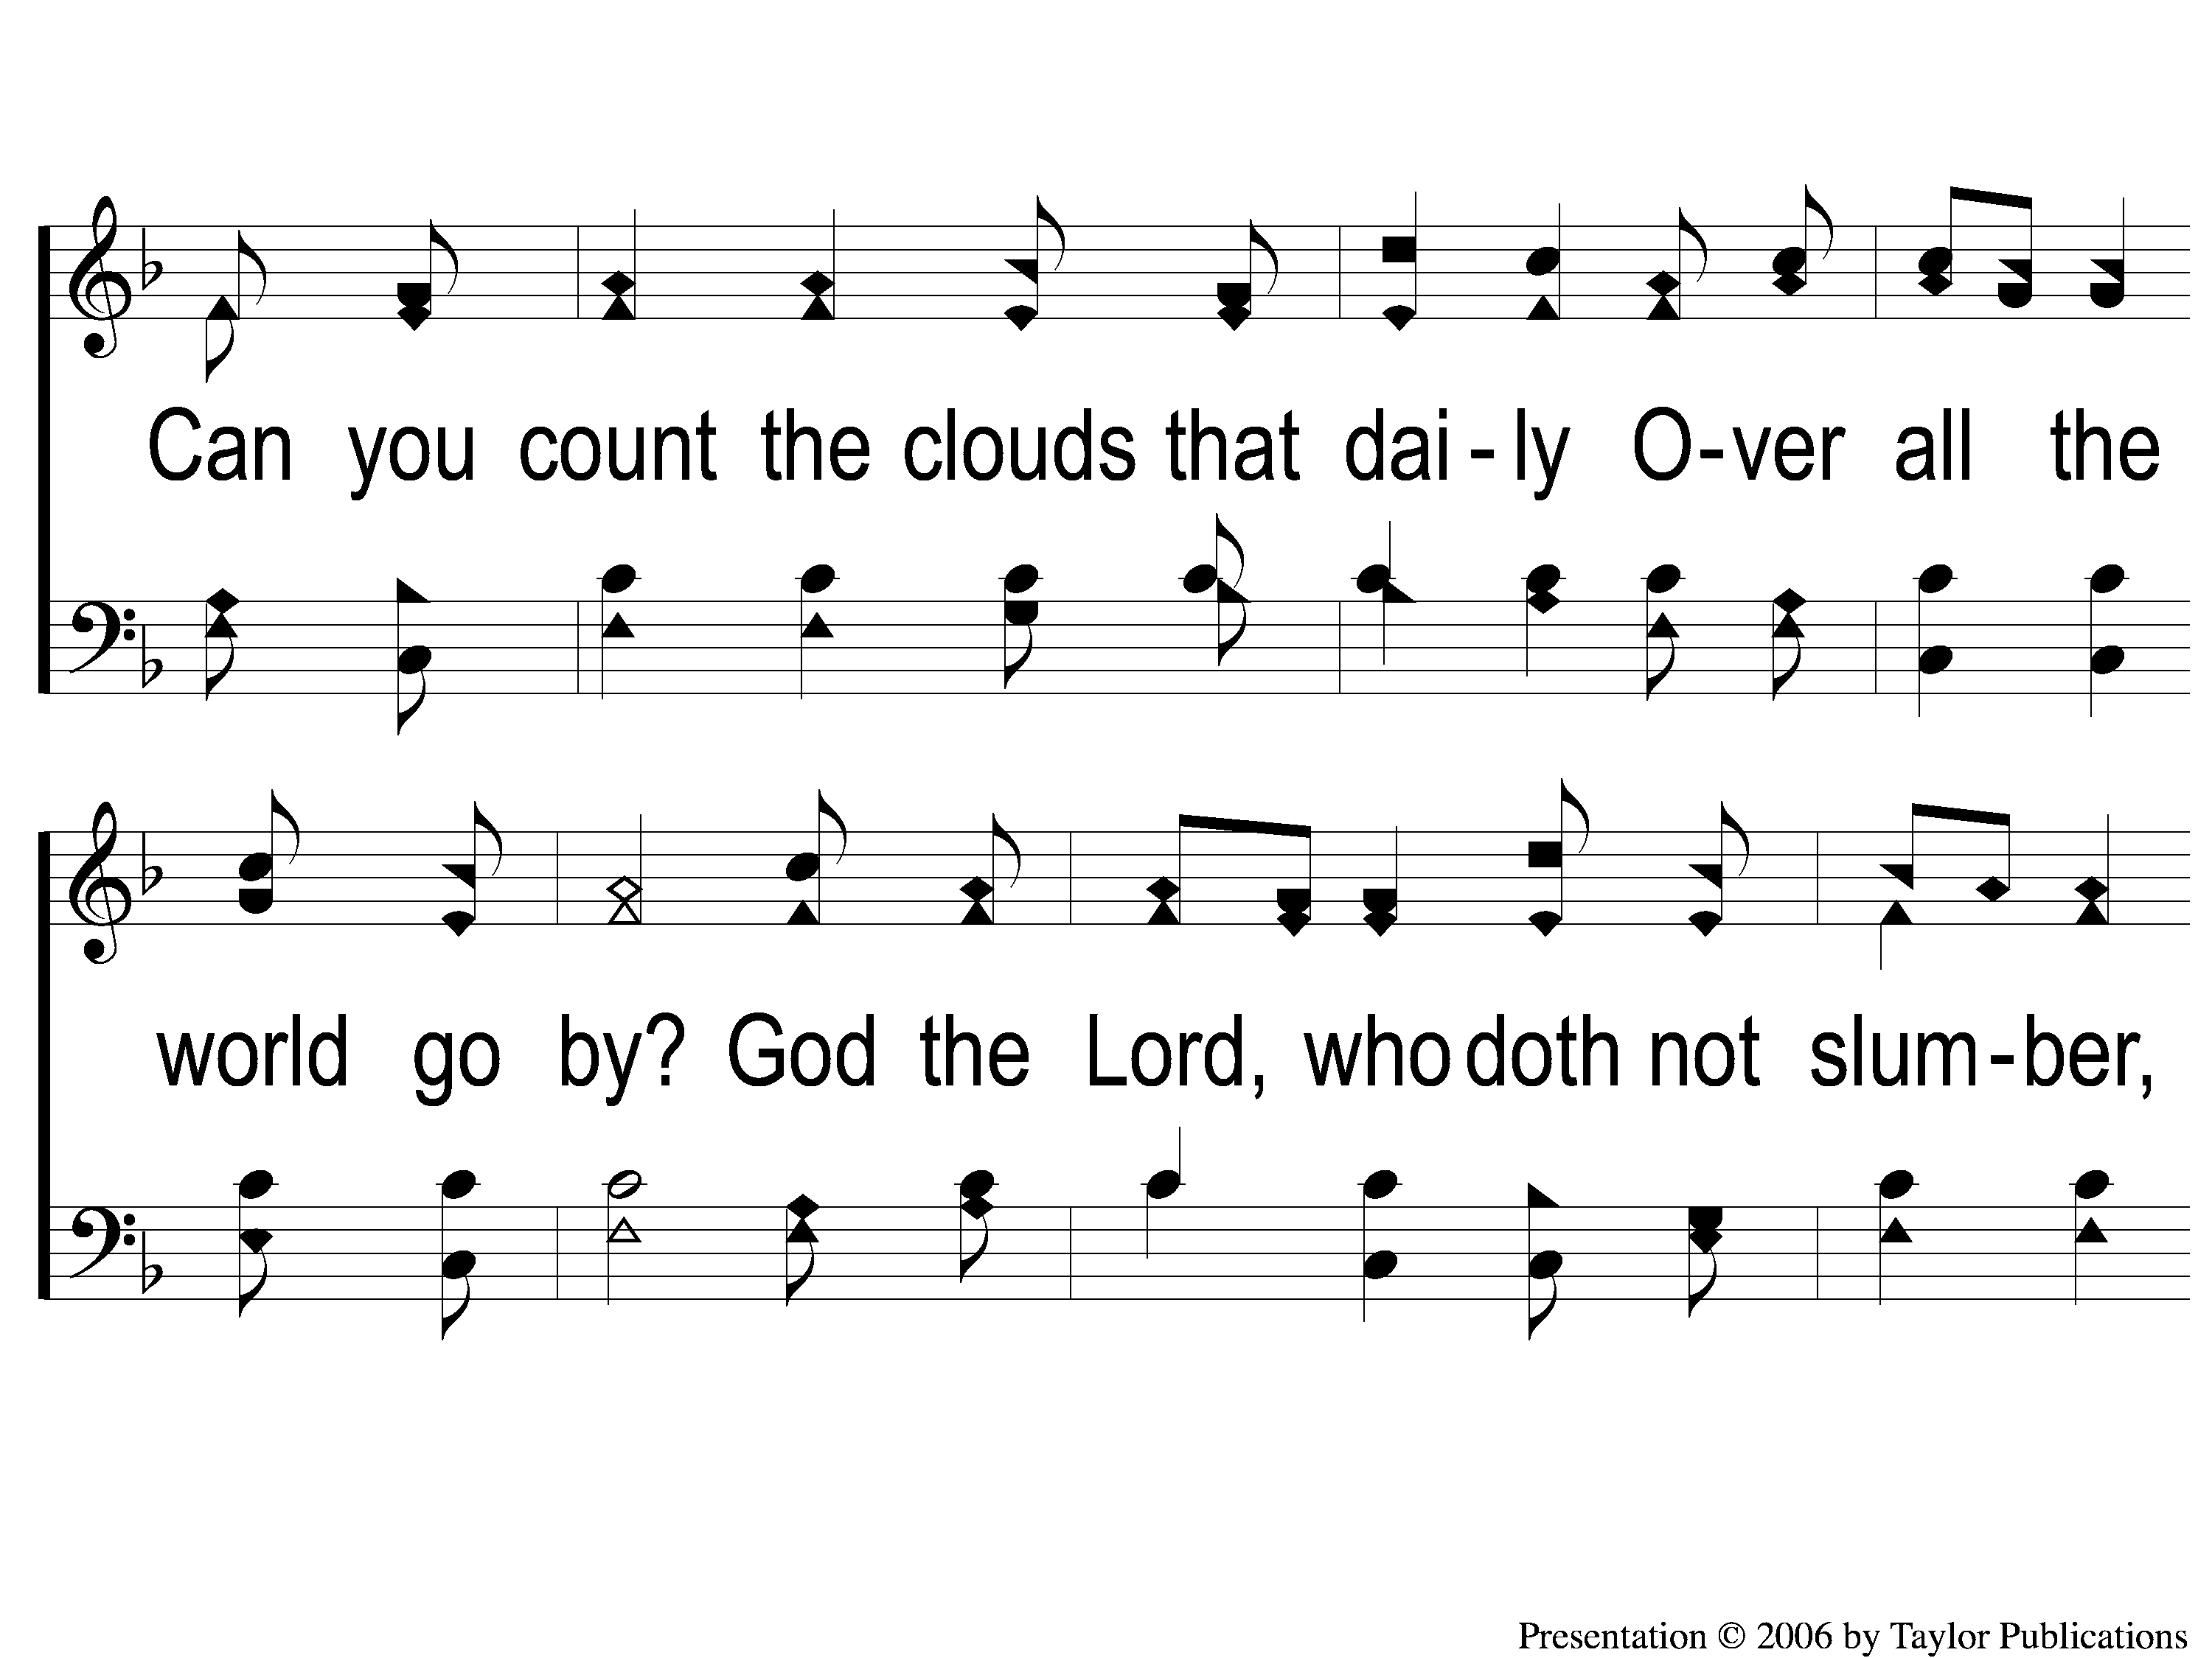
1-2 Can You Count the Stars?
Can You Count The Stars?
70

Slide 3
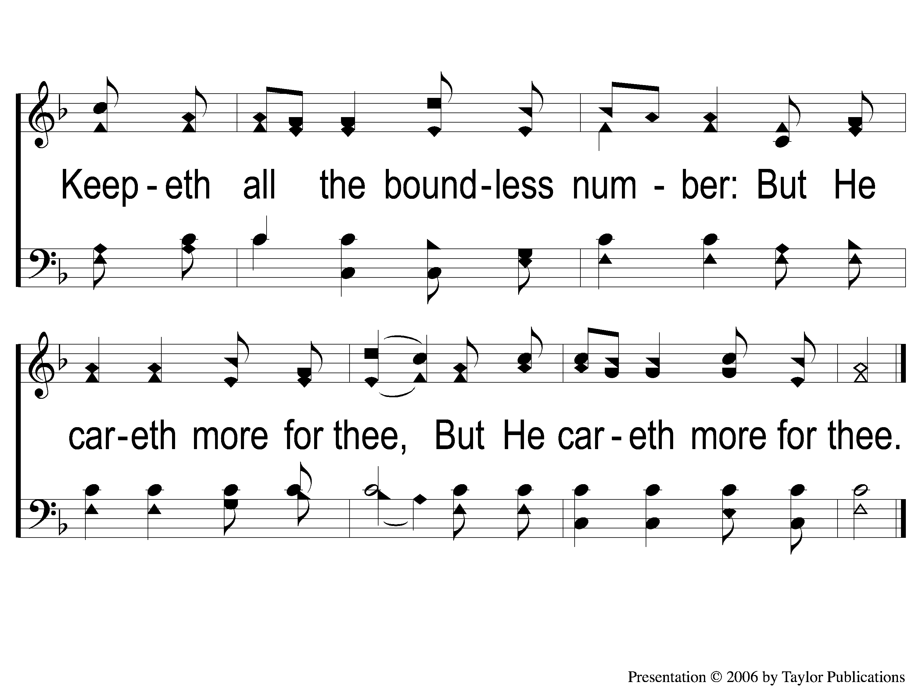
1-3 Can You Count the Stars?
70

Slide 4
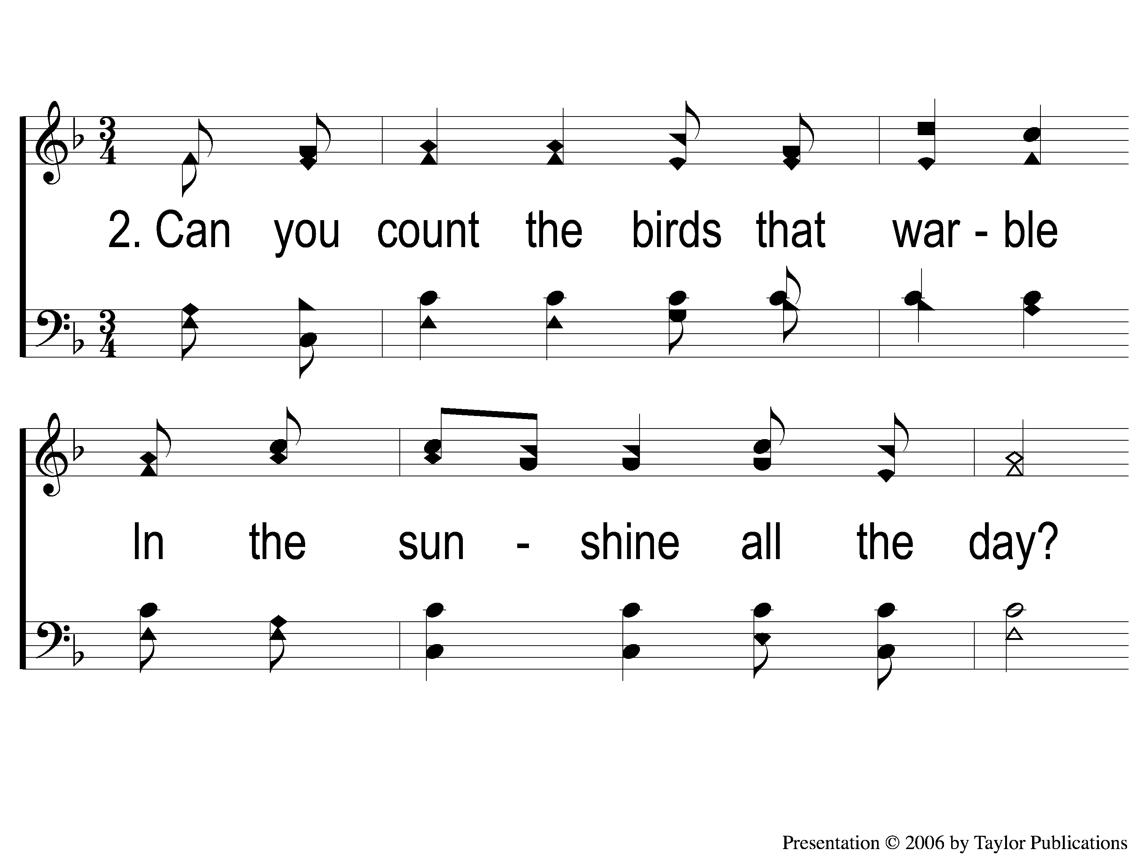
2-1 Can You Count the Stars?
Can You Count The Stars?
70

Slide 5
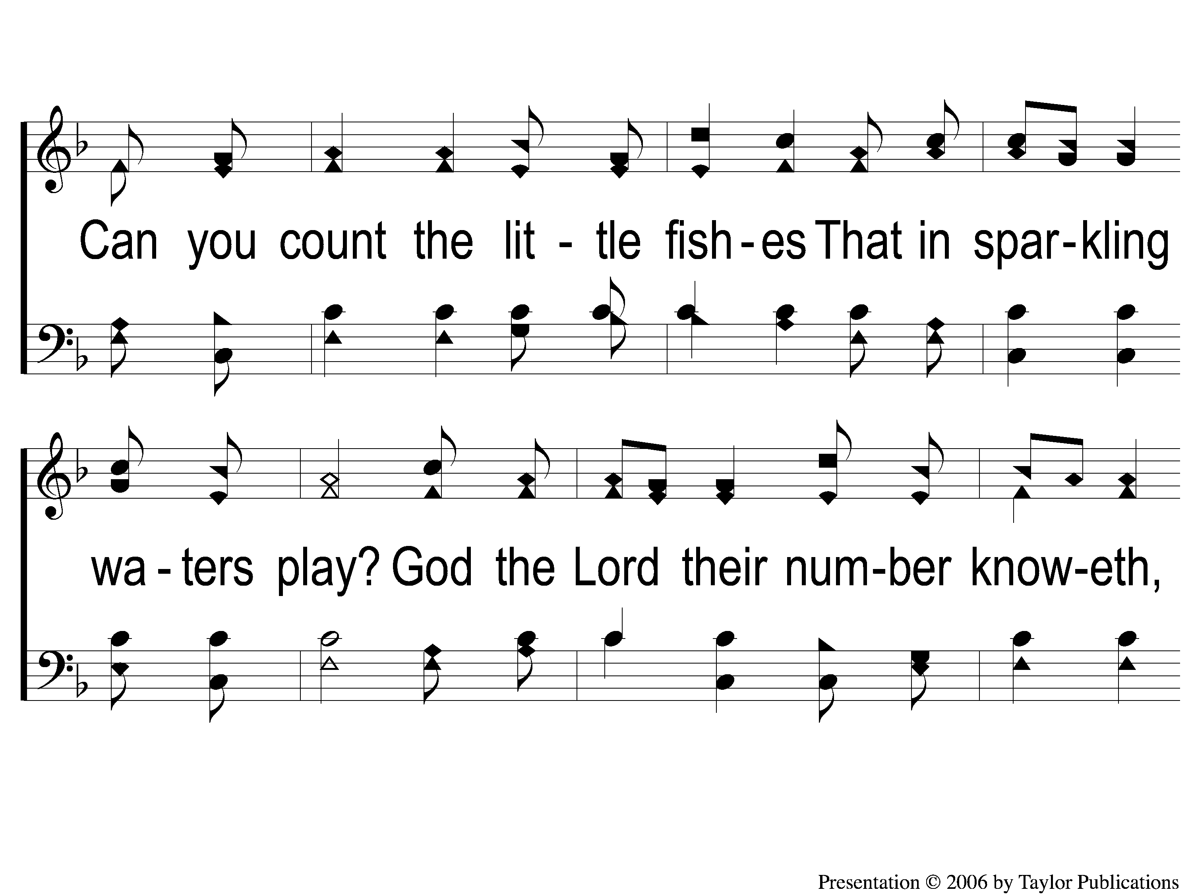
2-2 Can You Count the Stars?
Can You Count The Stars?
70

Slide 6
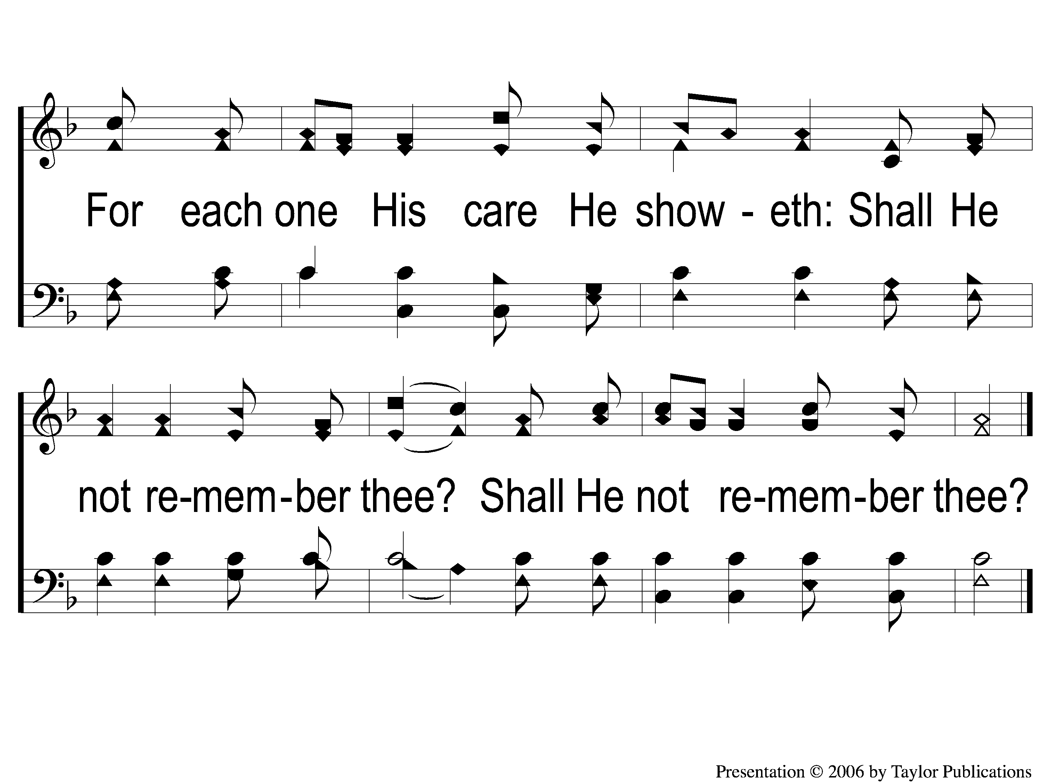
2-3 Can You Count the Stars?
Can You Count The Stars?
70

Slide 7
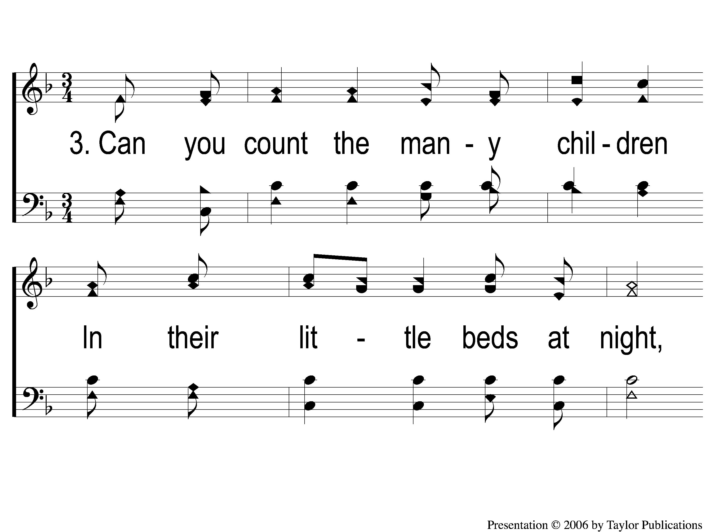
3-1 Can You Count the Stars?
Can You Count The Stars?
70

Slide 8
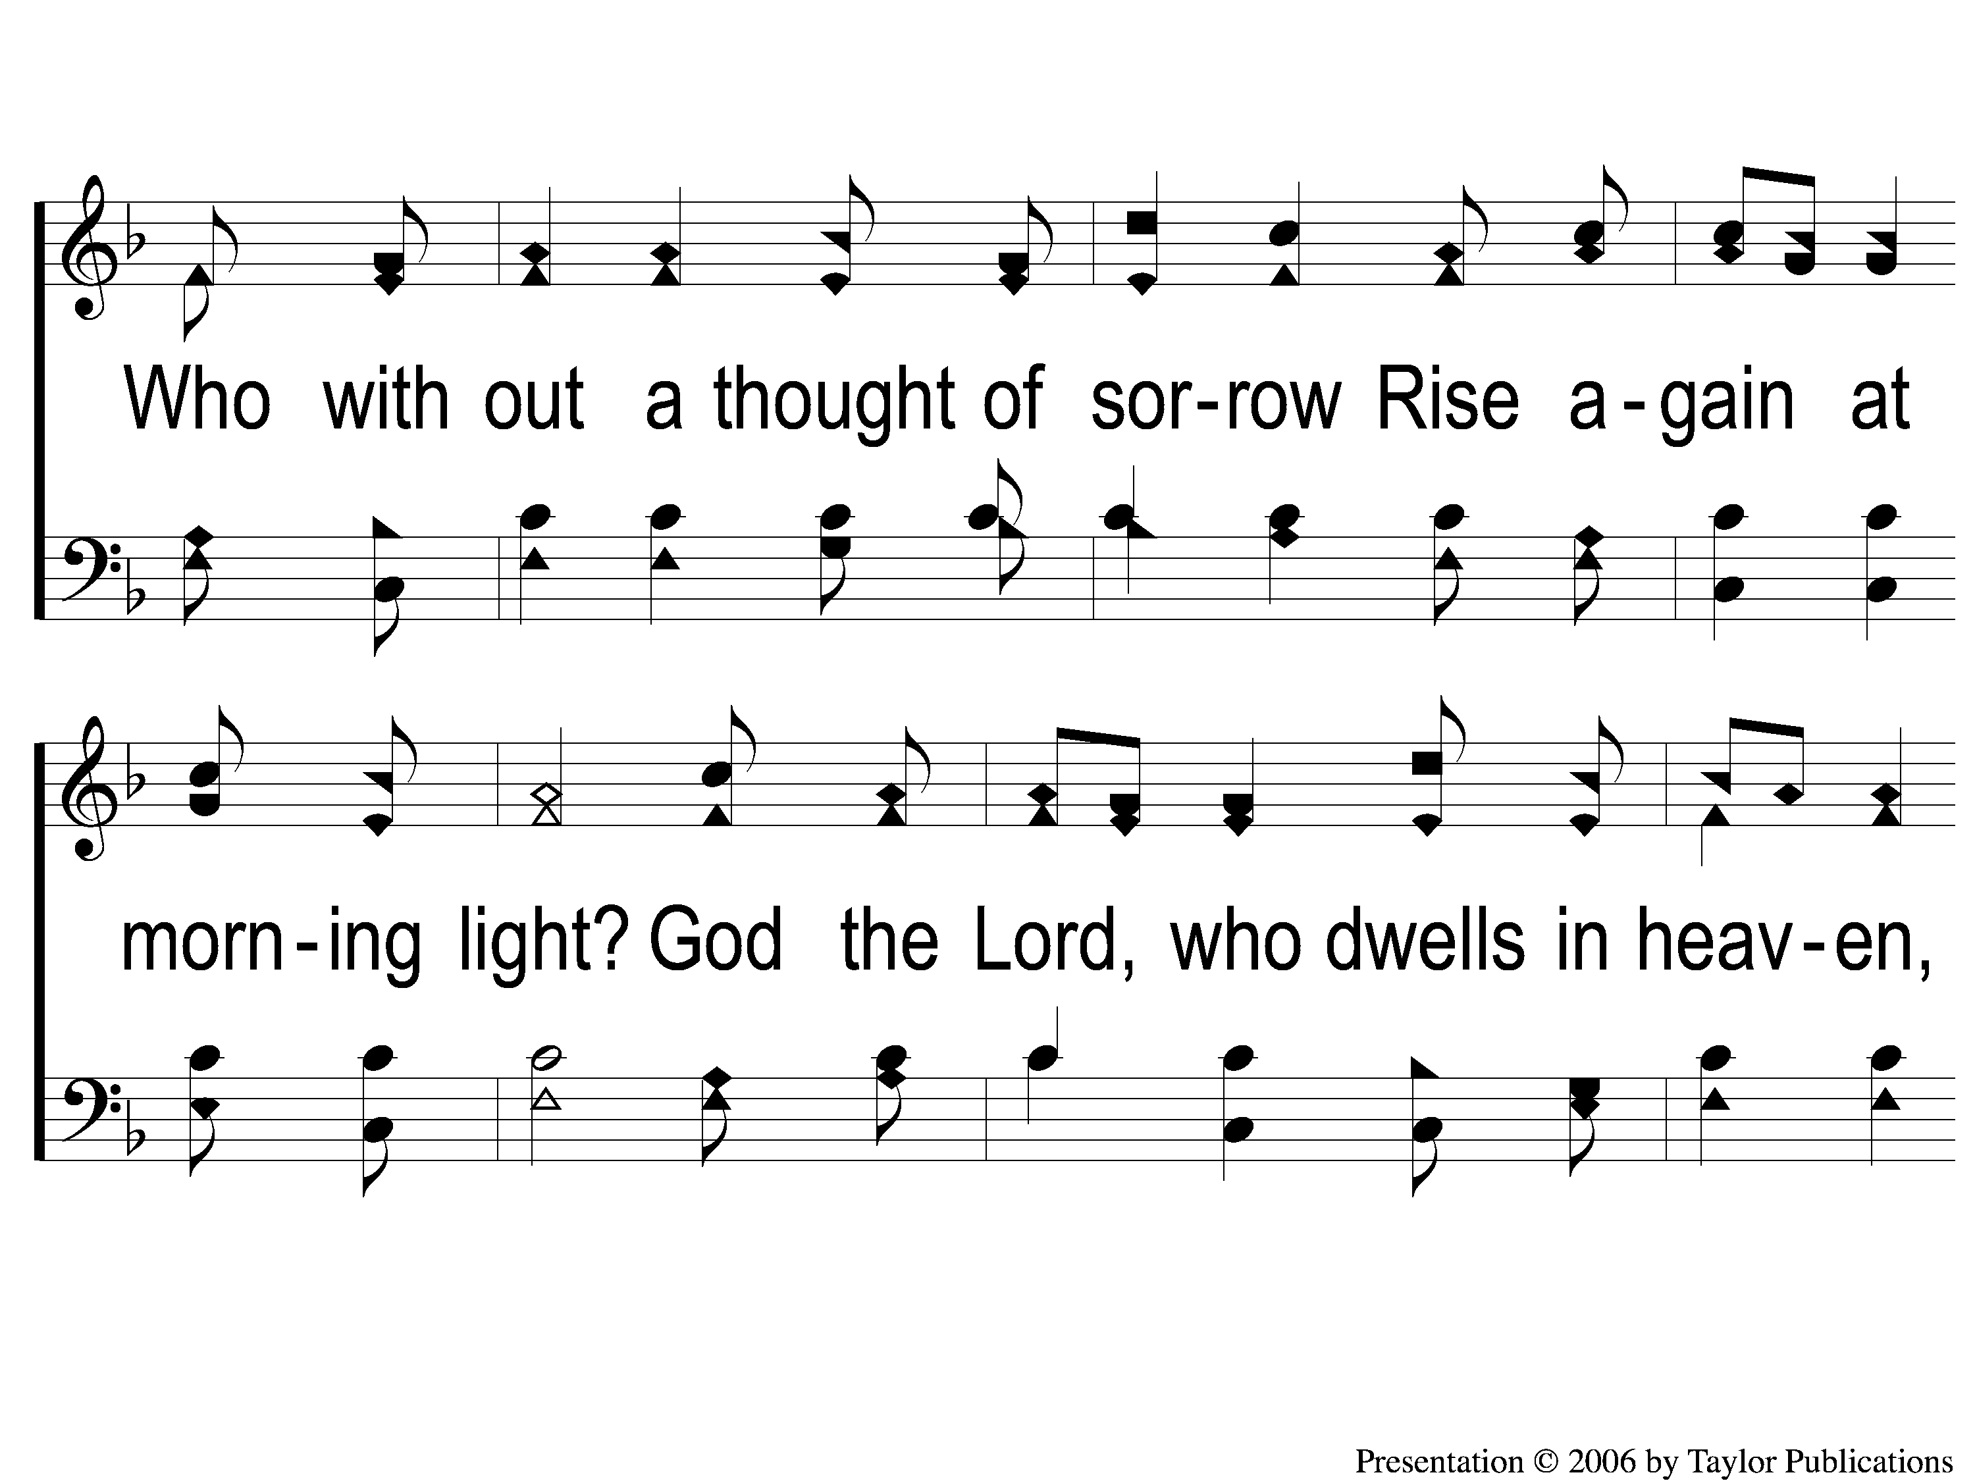
3-2 Can You Count the Stars?
Can You Count The Stars?
70

Slide 9
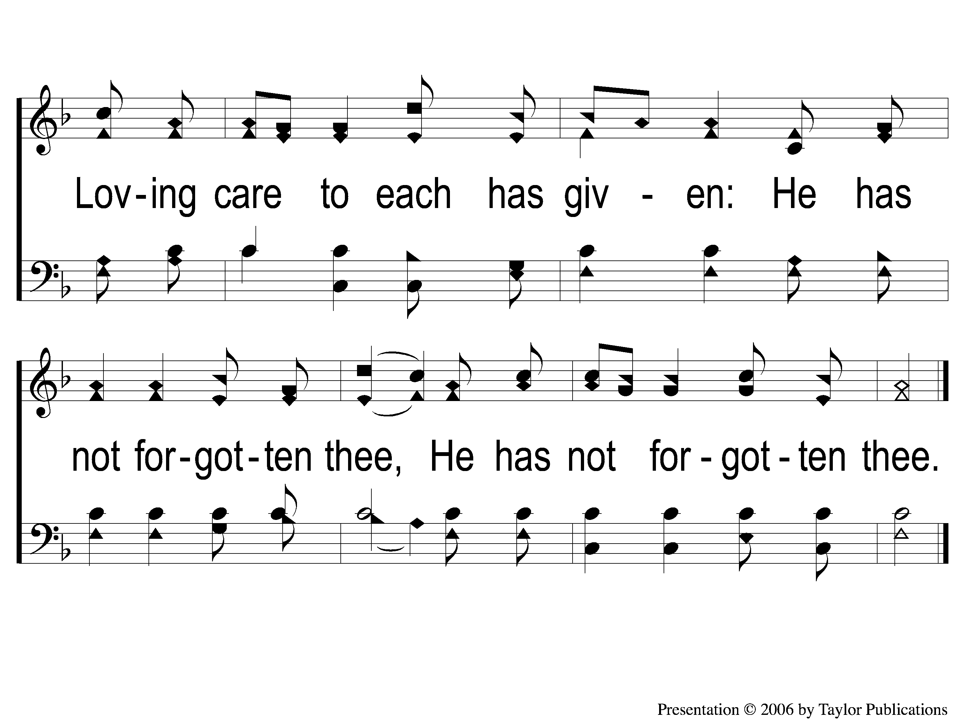
3-3 Can You Count the Stars?
Can You Count The Stars?
70

